Slide 1

Marketing Spend Optimization
ABC Ltd - 2024
Fernando Oviedo M

Slide 2



Agenda
Data Preparation
Findings
Derived Values
KPIs
Results
Prospects Analysis
Campaign Analysis
Engagement Score
Patterns & Anomalies
Closing
Summary
Questions and Answers

Slide 3
Data processing
Missing data and inconsistencies:
5% of data inconsistences marked for revision
12.5% of opt-in sources marked as unknown
Derived variables:
Region
Role
Standard Job title
KPI & scores:
Conversion rate
Engagement score
Funnell stage progress:
Awareness
interest
Consideration
intent

Slide 4
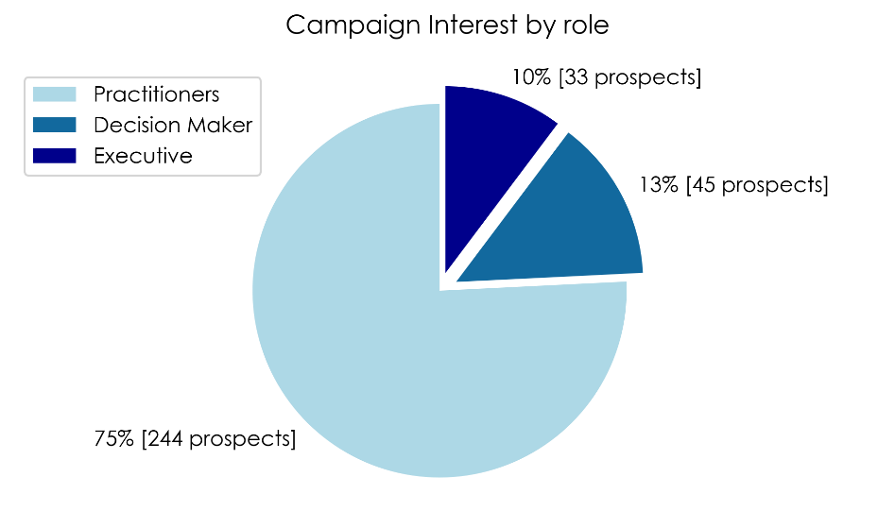
RESULTS
INTEREST
BEST PERFORMANCE CAMPAIGNS
OPT-INs DRIVER SOURCES
NORTHAM:
Halloween Spooktacular
100% Engagement
5 prospect reachability
APAC:
Annual Fall Clearance
100% Engagement
4 prospect reachability
EMEA:
Spring Blowout Sale
100% Engagement
3 prospect reachability
LATAM:
Annual Fall Clearance
100% Engagement
3 prospect reachability
50% of catalog opt-in was driven by 3 sources in each region where online services and referral programs stand out as main drivers.
75% of the prospects reached have a practitioner role.
13% of the population reached are decision makers.

Slide 5
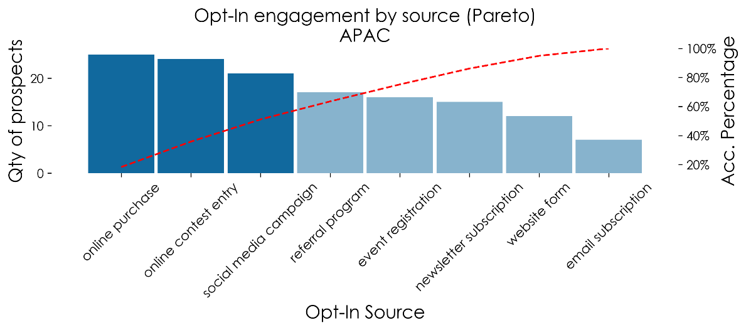
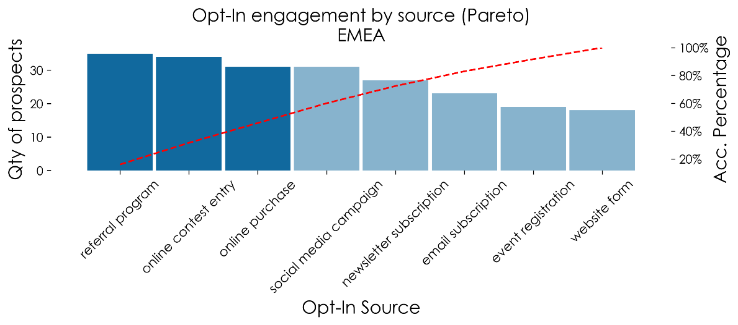
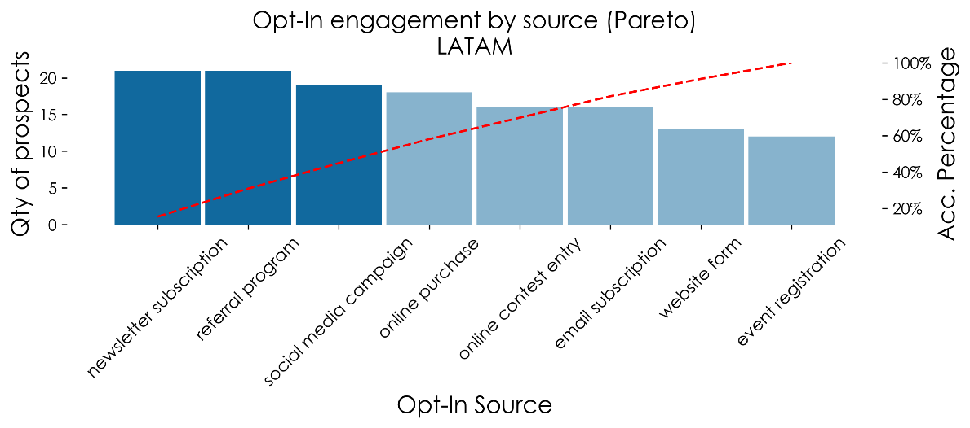
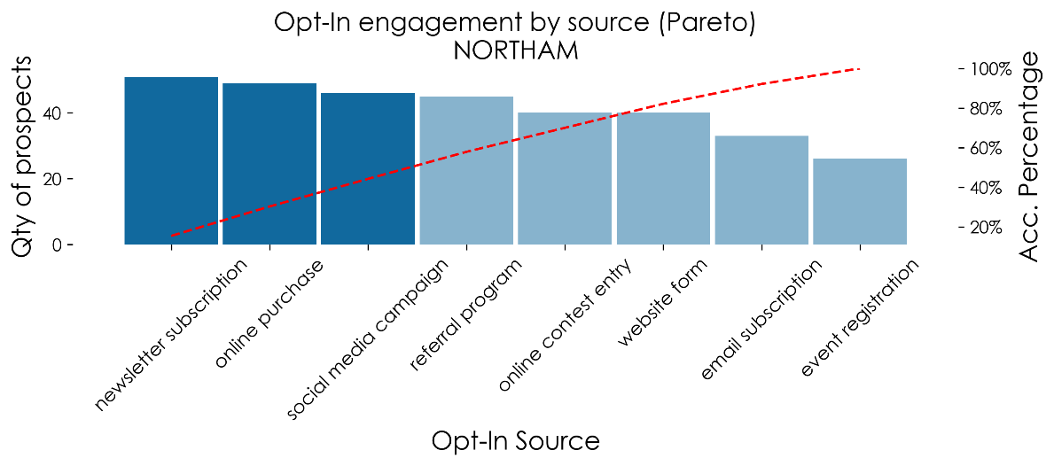
[Back-up-Slide] Opt-in by source Pareto analysis

Slide 6
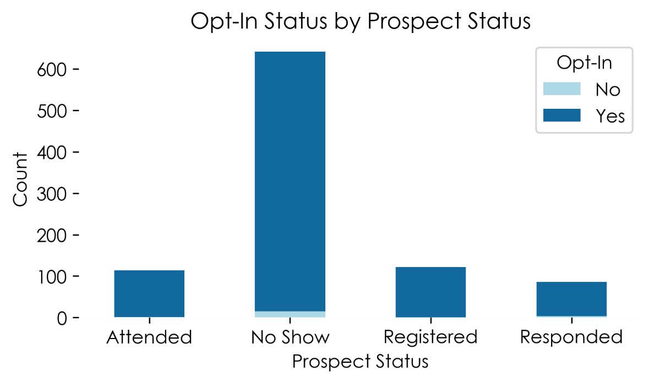
RESULTS
INTEREST
Feature correlations
Prospect’s job title vs sign-up :
No statistical correlation (p = 0.5).
While job titles might be a logical way to segment prospects, it. doesn't significantly dictate their interest in the product's trial sign-ups.
Prospect’s region vs sign-up:
Statistical results suggest that the region does not define if a prospect will register for a free trial sign-up (p = 0.9).
Most prospects who responded, attended, or registered opted in to receive communications.
Even among those who were no-shows, a significant number had opted in.
The high opt-in rates across all statuses could indicate that opting in does not necessarily predict higher engagement or conversion.

Slide 7
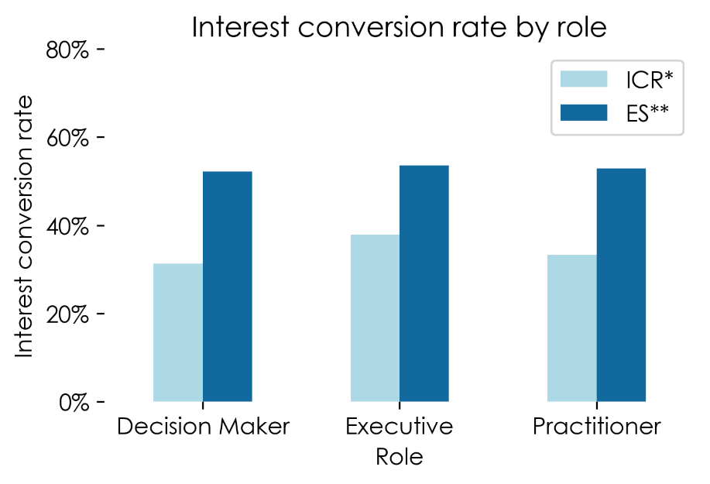
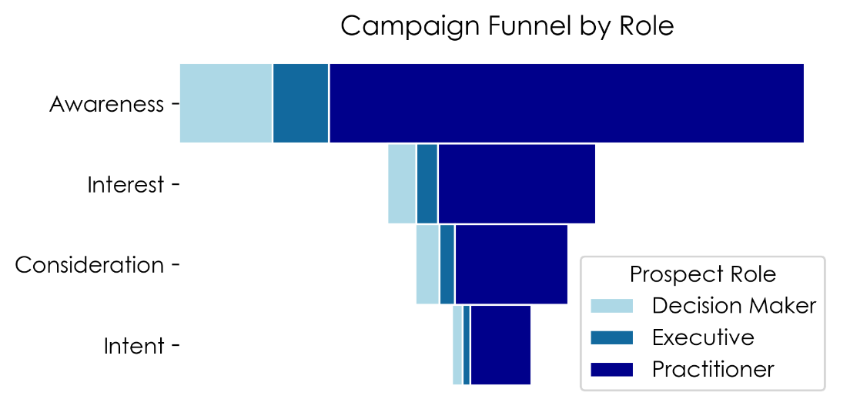
RESULTS
PROSPECT ENGAGEMENT
INTEREST
Campaign Funnel dynamic simulation shows the behavior of the different roles across each stage of the campaign. A uniform reduction in the conversion by role can be inferred, which aligns with the final ES metric.
The decision-maker role shows the lowest ICR with 43%.
Executive and Practitioner roles show ICR of 50% and 54%, respectively.
ES for all the roles shows a 52.9±0.7% suggesting a remaining stable engagement across each of the prospect's roles.
* Intent Conversion Rate
** Engagement Score

Slide 8
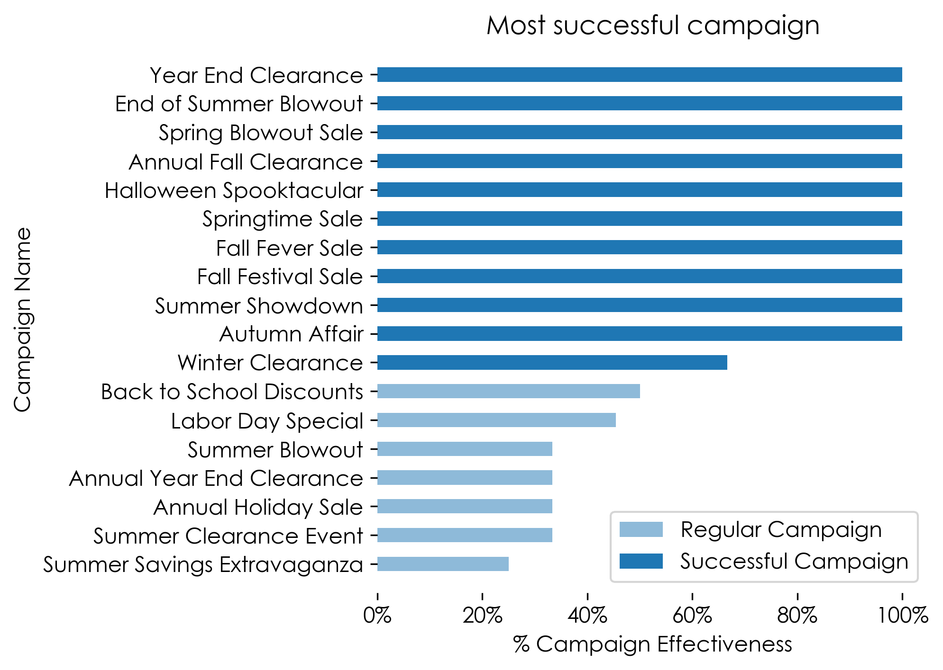
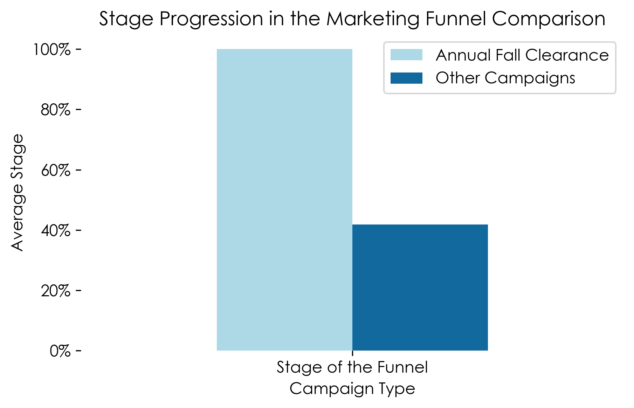
RESULTS
CAMPAIGN SUCCESS
MOST SUCCESFULL VS OTHER CAMPAIGN
Annual Fall Clearance:
All prospects reached the final stage of the marketing funnel, demonstrating full progression.
Other Campaigns:
The average progression is significantly lower, at approximately 41.9%
60% of the marketing campaigns achieved more than 67% effectiveness (awareness stage converted to Intent stage).

Slide 9
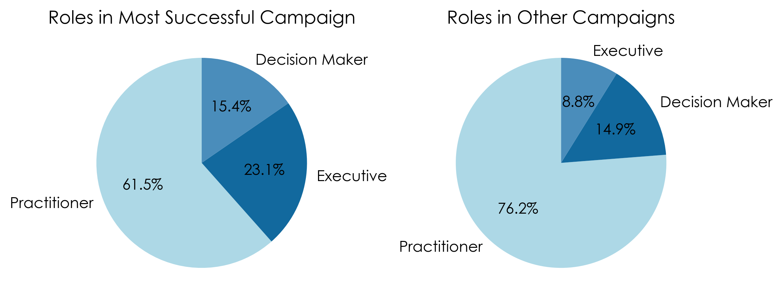
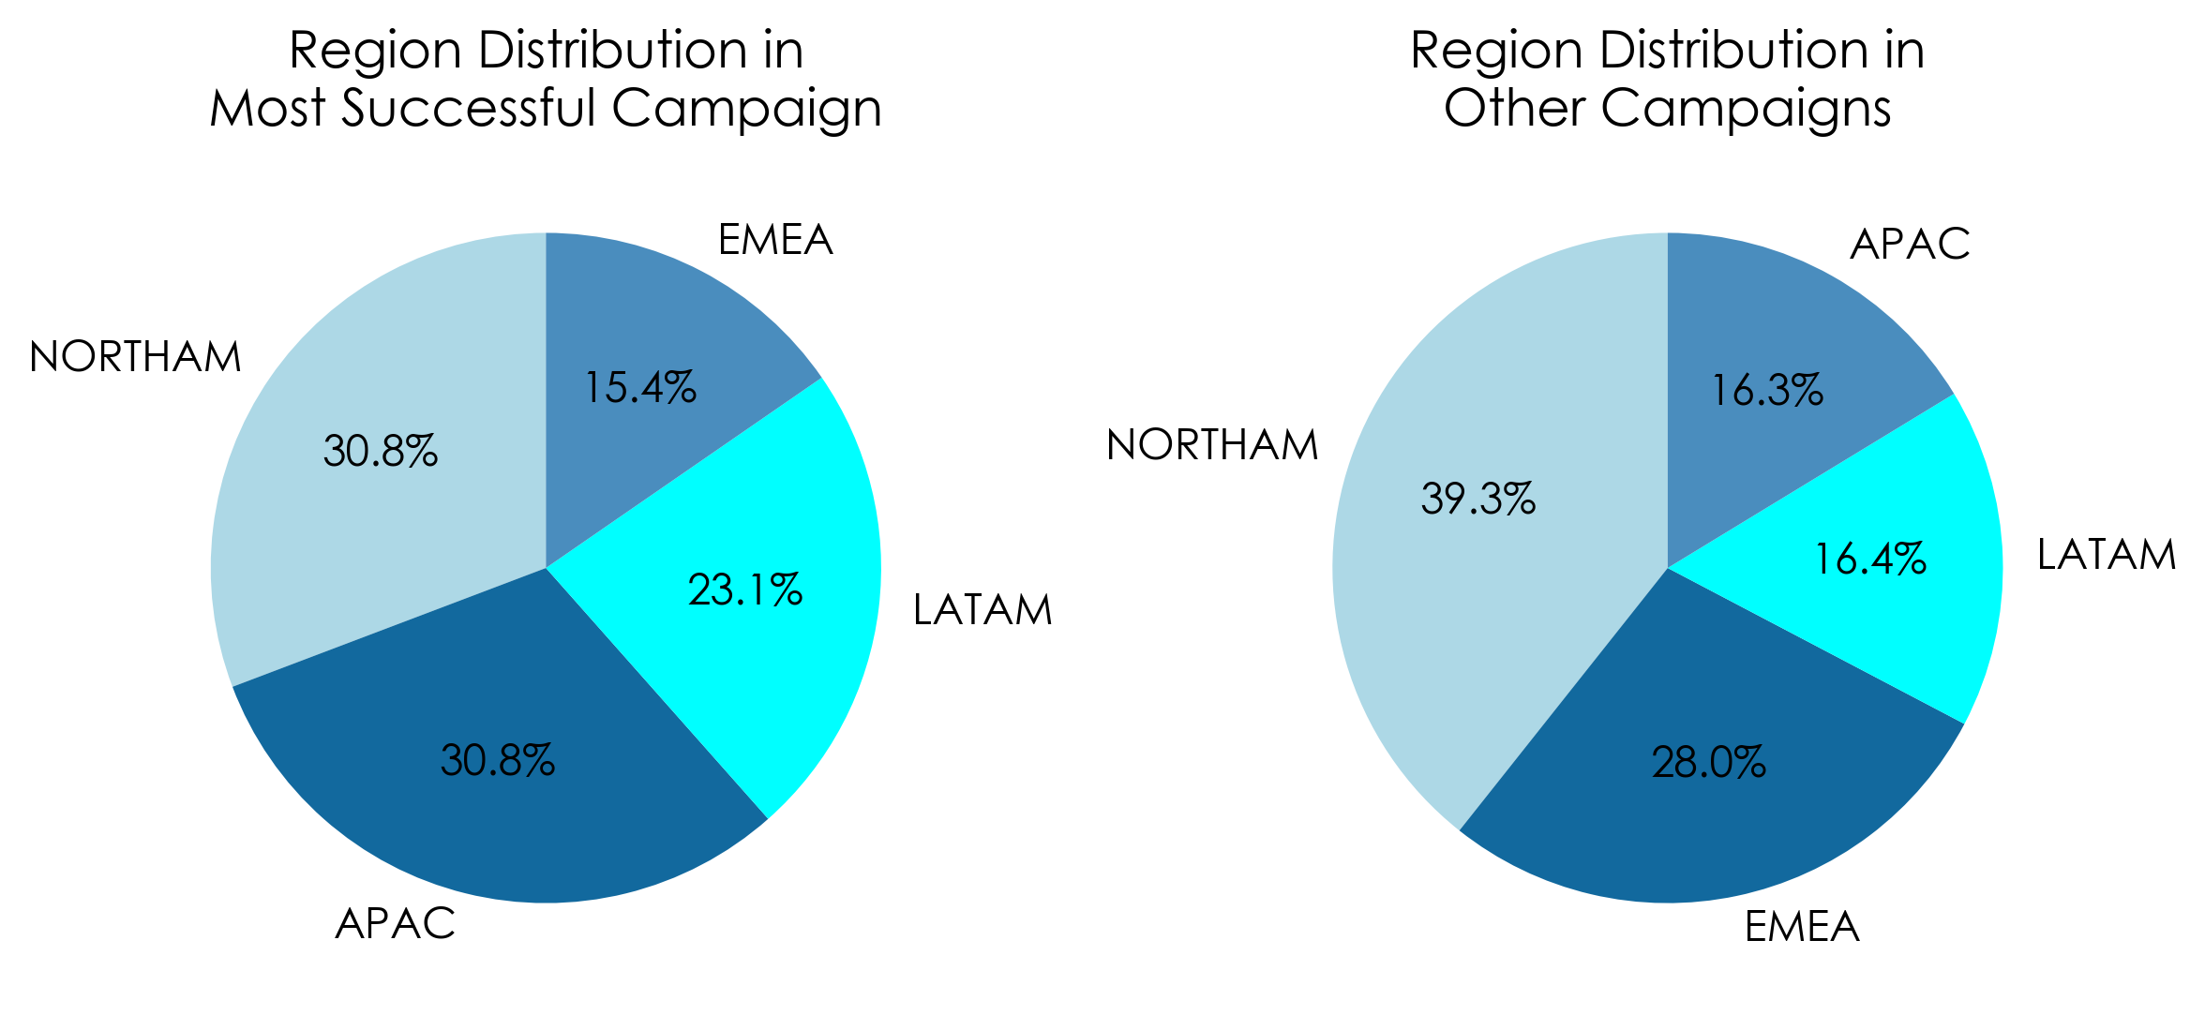
RESULTS
CAMPAIGN SUCCESS
MOST SUCCESFULL VS OTHER CAMPAIGN
The most successful campaign had a higher proportion of executives and decision-makers compared to other campaigns.
The most successful campaign shows a nearly even distribution across NORTHAM, APAC, LATAM, and EMEA.
Other campaigns have a stronger presence in NORTHAM, followed by EMEA.

Slide 10
Reflecting back
Highlights
Engagement:
Predominantly practitioners engaged, with substantial participation from decision-makers and executives.
Regional Campaign Highlights:
NORTHAM's "Halloween Spooktacular" and APAC/LATAM's "Annual Fall Clearance" achieved 100% engagement, showcasing successful targeting.
Opt-In Dynamics:
Online services and the power of referrals were confirmed as critical pathways, jointly accounting for half of the opt-ins.
Engagement vs. Conversion:
Despite high interest across roles, the opt-in action did not consistently translate into higher funnel progression.
Data-Driven Insights:
Neither job titles nor regional data alone predicted trial sign-ups, hinting at a multilayered decision-making process.
Strategic Success Indicators:
The most effective campaigns featured a diverse regional reach and resonated well with upper management.
Funnel Effectiveness:
"Annual Fall Clearance" stood out, demonstrating full funnel progression from awareness to intent, far exceeding other campaigns.
Strategic Recommendations for Future Initiatives:
Maintain and enhance investment in digital and referral marketing channels.
Consider A/B testing for deeper insights and to refine campaign effectiveness.
Some campaigns showed a high awareness rate, the strategy used can be analyzed to try to transform these prospects into registration by replicating the most successful campaigns approach.

Slide 11

Question

